Slide 1
Pattern Sense: Classifying Fabric Patterns Using Deep Learning

Slide 2
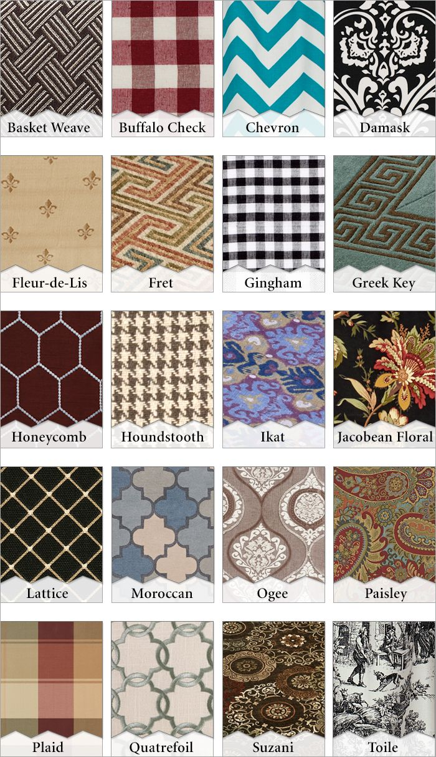
Introduction to Fabric Pattern Classification
Fabric pattern classification involves identifying and categorizing various textile designs.
Accurate classification can improve quality control, inventory management, and fashion design.
Deep learning has emerged as a powerful approach for automating pattern recognition tasks.
1
Notes:
Image source: https://i.pinimg.com

Slide 3
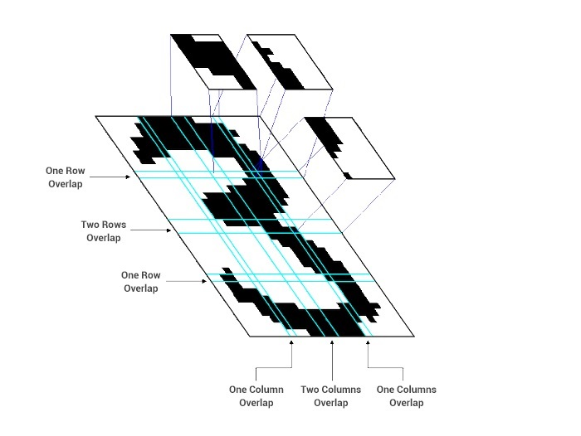
Importance of Pattern Recognition in Textiles
Recognizing fabric patterns enhances manufacturing efficiency and reduces errors.
It helps in cataloging and searching textile databases more effectively.
Automated pattern recognition supports customization and trend analysis in the fashion industry.
2
Notes:
Image source: https://images.deepai.org

Slide 4
Challenges in Fabric Pattern Classification
Variability in fabric textures, lighting, and fabric wear can complicate recognition.
Similar patterns may have subtle differences that are difficult to distinguish.
Traditional machine learning methods often require extensive feature engineering to perform well.
3
Notes:
Image source: https://i.pinimg.com

Slide 5
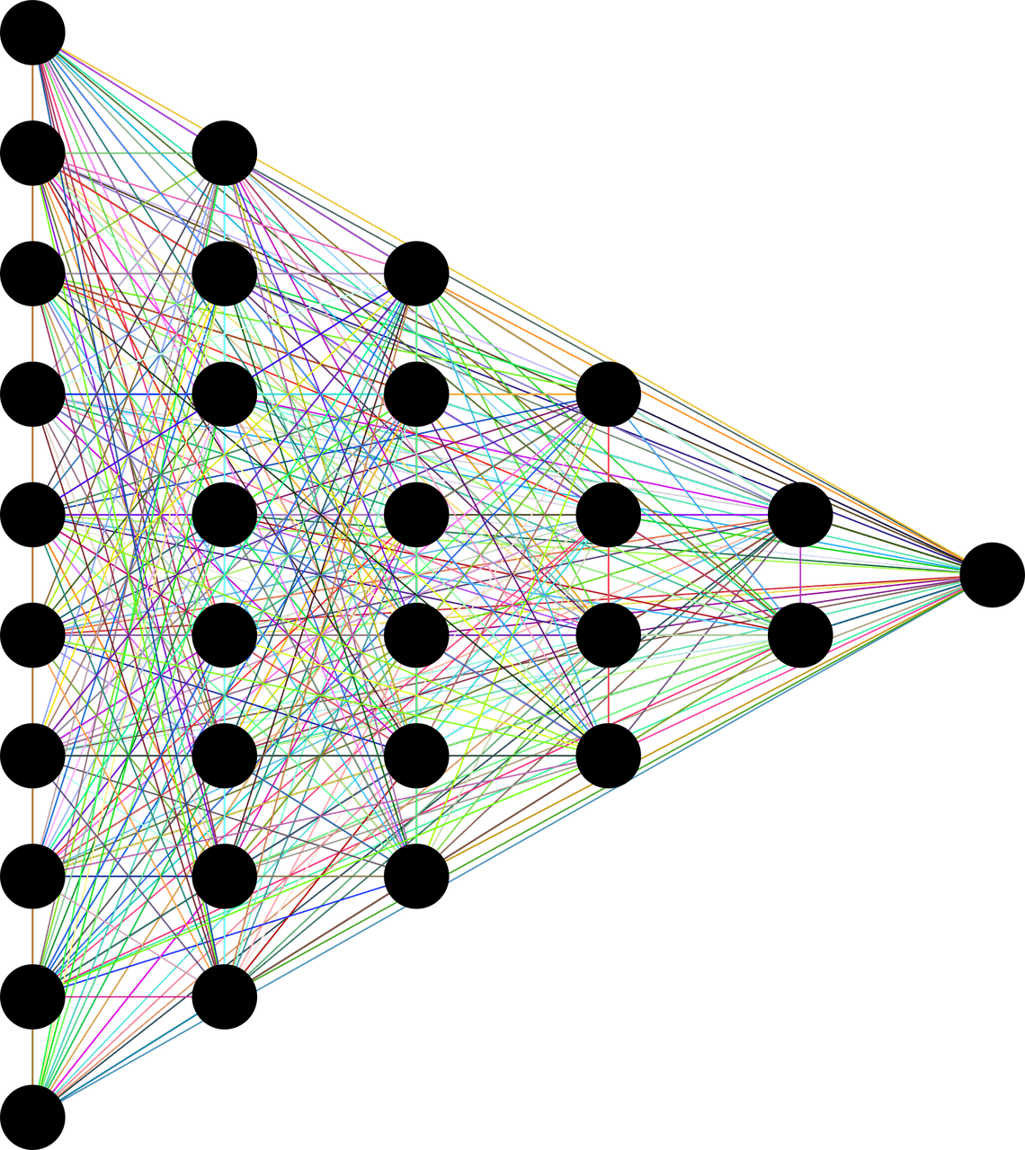
Deep Learning Approach Overview
Convolutional Neural Networks (CNNs) are commonly used for image-based pattern classification.
CNNs automatically learn hierarchical features from raw images, reducing manual effort.
Deep learning models can handle complex patterns and variations more effectively than traditional methods.
4
Notes:
Image source: https://cdn.analyticsvidhya.com

Slide 6
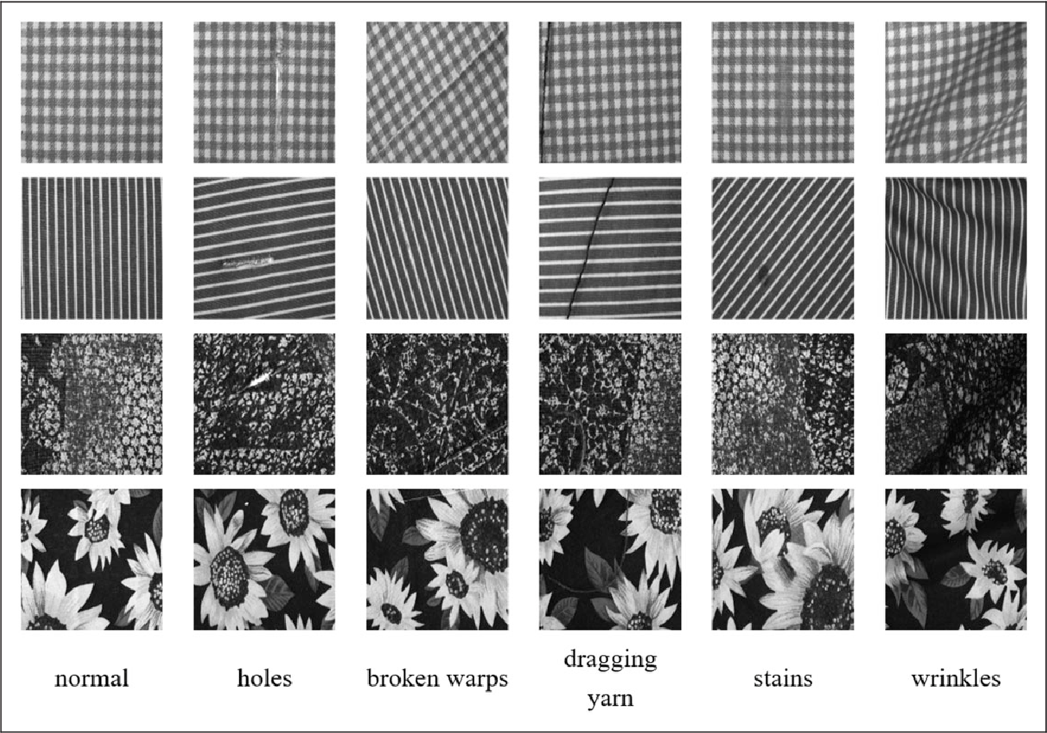
Data Collection and Preprocessing
A diverse dataset of fabric images is essential for training robust deep learning models.
Data augmentation techniques such as rotation, scaling, and color adjustments improve generalization.
Preprocessing steps include normalization, resizing, and noise reduction to optimize model performance.
5
Notes:
Image source: https://ai2-s2-public.s3.amazonaws.com

Slide 7
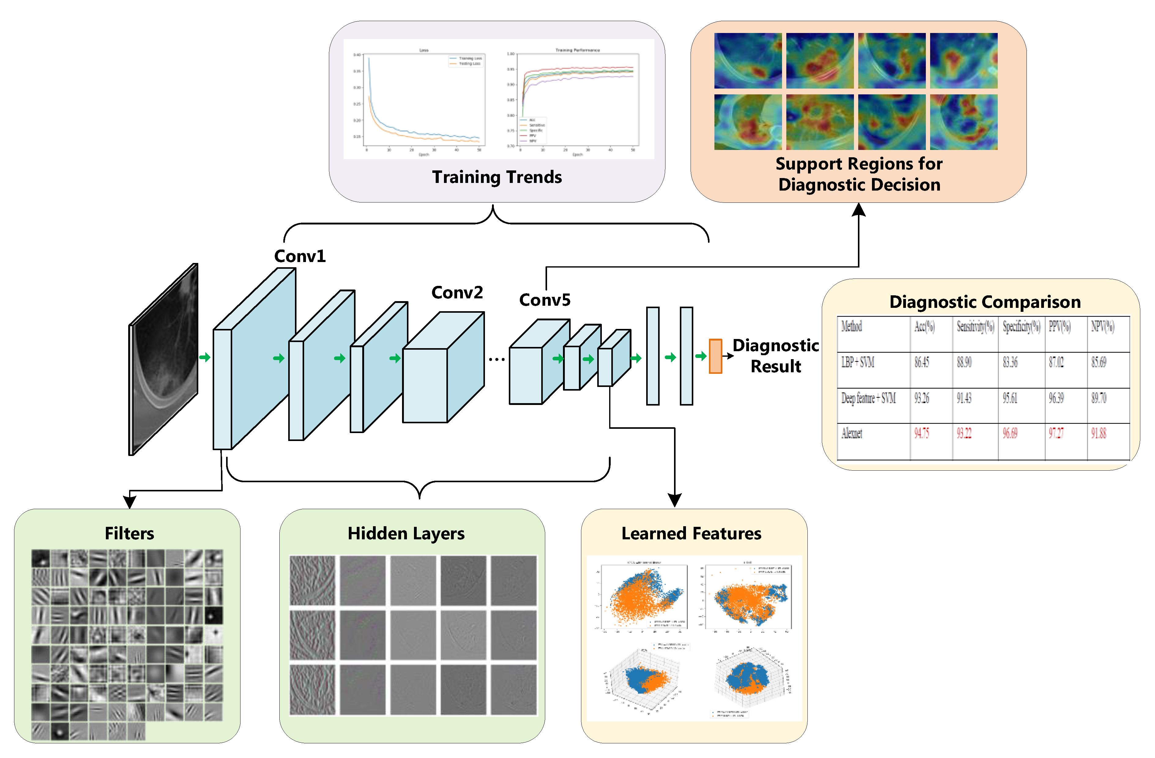
Model Architecture and Training
Popular CNN architectures like ResNet, VGG, or EfficientNet can be adapted for fabric pattern classification.
Transfer learning allows leveraging pre-trained models to improve accuracy with limited data.
Model training involves optimizing loss functions, tuning hyperparameters, and validating performance on separate datasets.
6
Notes:
Image source: https://www.mdpi.com

Slide 8
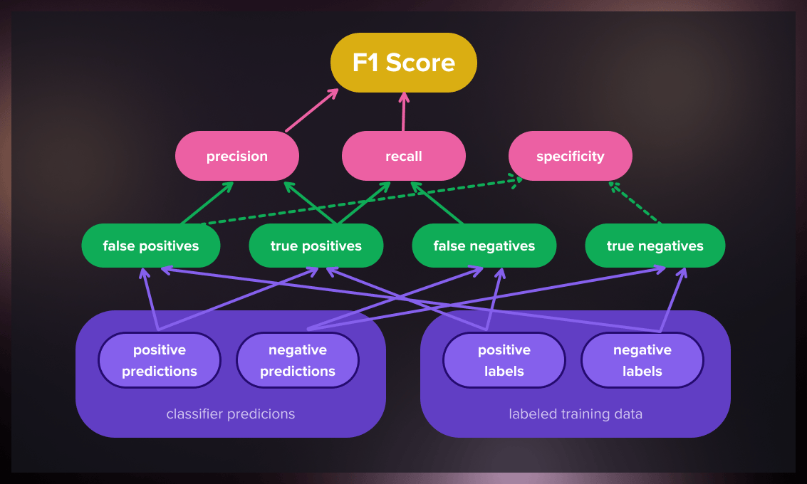
Evaluation Metrics and Results
Accuracy, precision, recall, and F1-score are commonly used metrics to assess model performance.
Confusion matrices provide insights into specific pattern misclassifications.
Experimental results demonstrate that deep learning models outperform traditional approaches in fabric pattern classification.
7
Notes:
Image source: https://serokell.io

Slide 9
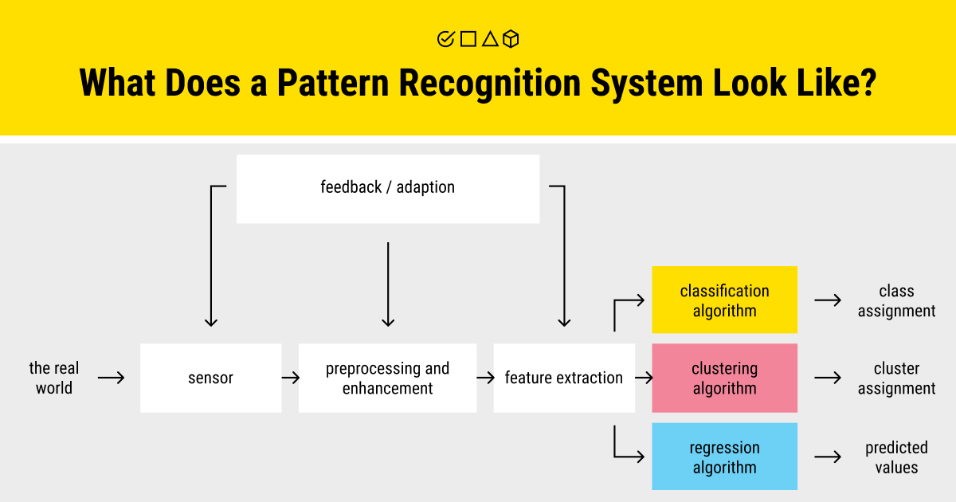
Applications and Benefits
Automated fabric pattern classification accelerates textile production and quality assurance.
It enables better inventory management through precise pattern identification.
The technology supports innovative fashion design and personalized fabric recommendations.
8
Notes:
Image source: https://labelyourdata.com

Slide 10
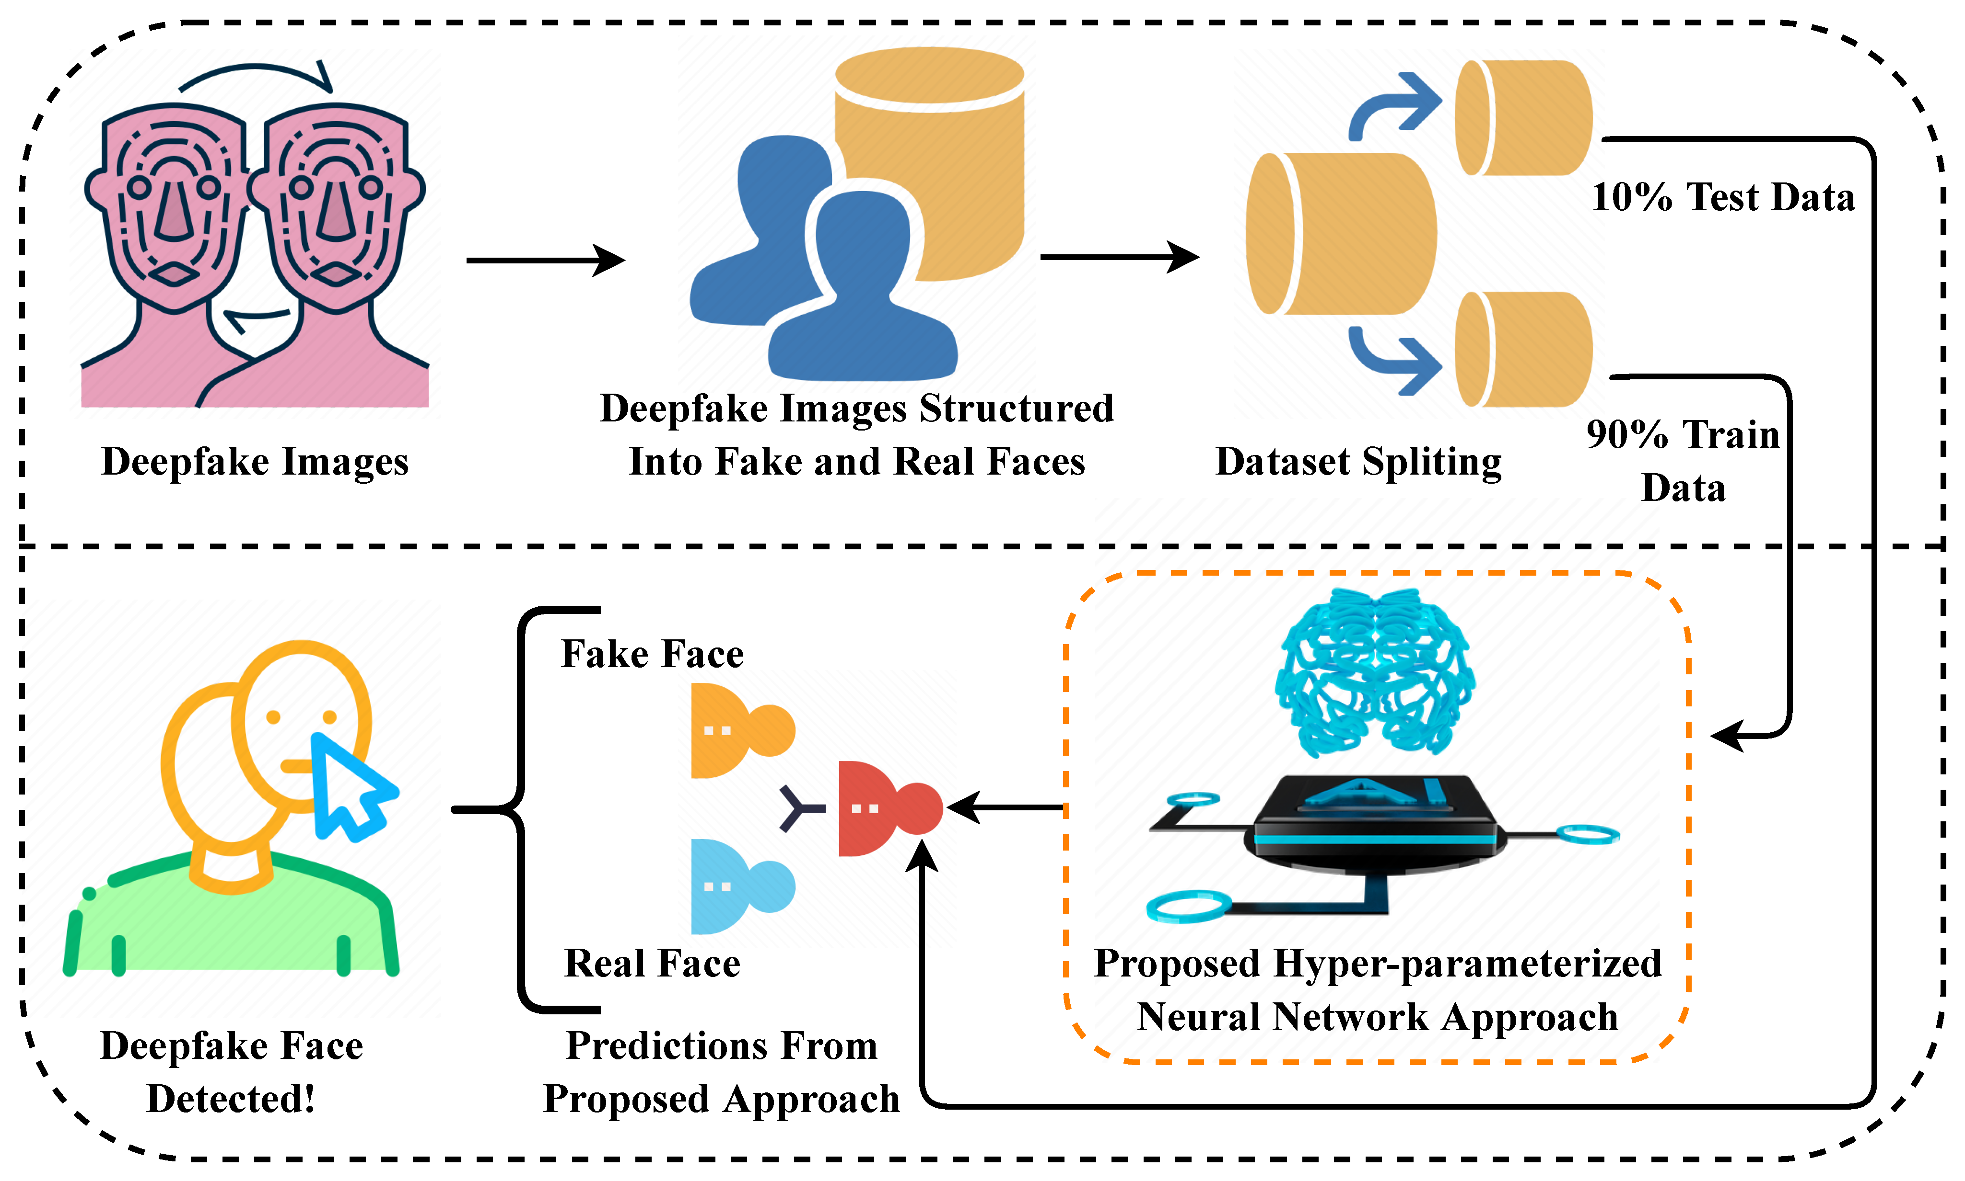
Future Directions and Challenges
Incorporating multimodal data, such as fabric texture and material properties, could enhance accuracy.
Developing lightweight models for deployment on mobile or edge devices is an ongoing area of research.
Addressing class imbalance and expanding datasets are critical for improving model robustness.
9
Notes:
Image source: https://pub.mdpi-res.com

